Slide 1

Boston Home Prices
Anthony Palumbo - Principal Data Scientist at Boston Realty

Slide 2
Introduction
- Looking at median value of owner-occupied homes in $1000s.
- 2 Main Categories-
- Size
- Location
-Area quality
How to use this model:
-Predict value of new houses

Slide 3
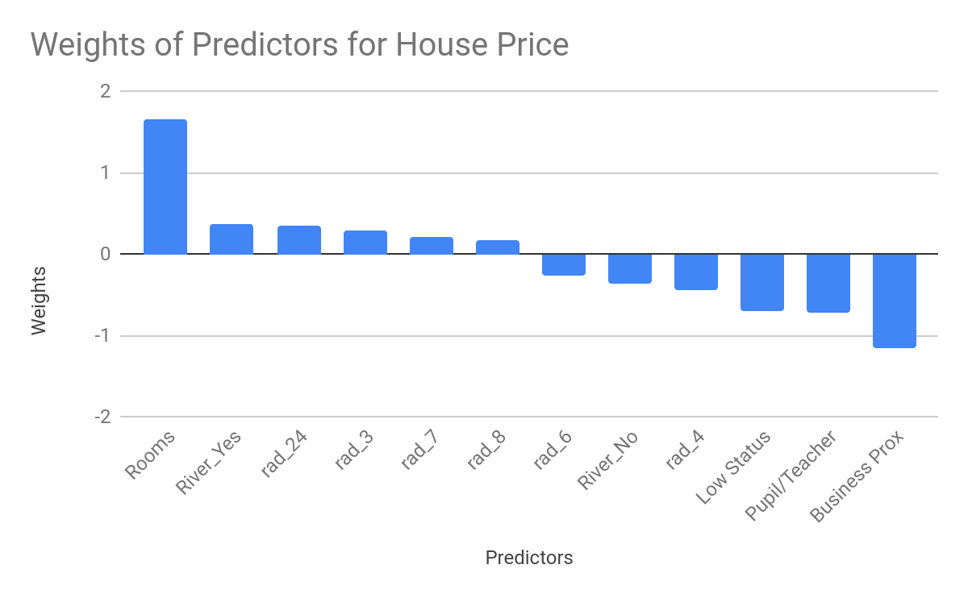

Slide 4
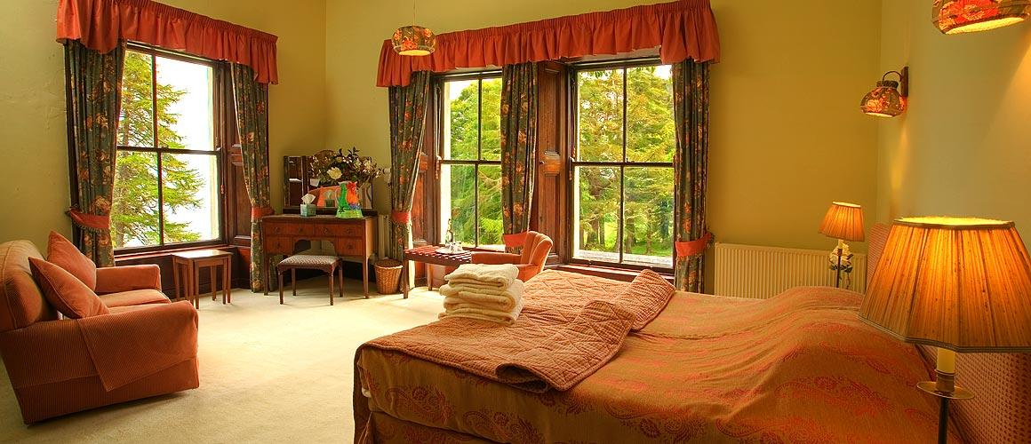
Rooms: i.e: Size of the House
-For every extra room, the value of the house goes up $1,668

Slide 5

Location Location Location

Slide 6
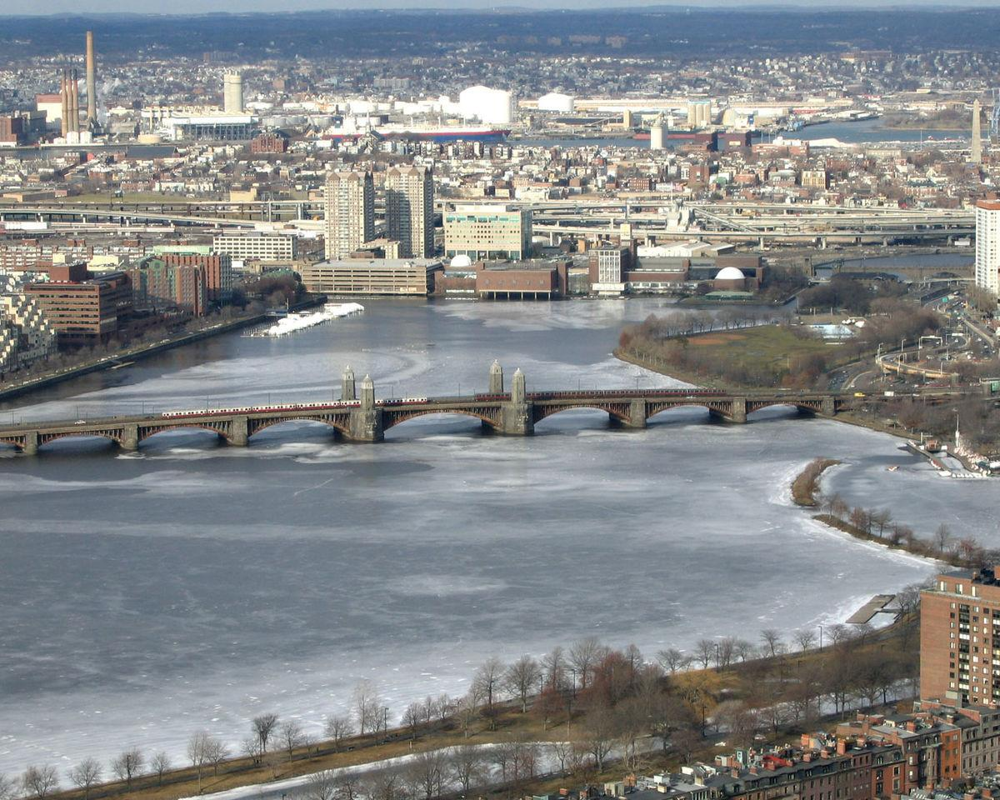
The Importance of the River
-Added $728 as opposed to not being on the Charles River(2*River_yes)

Slide 7

Distance to Businesses
-Closer you are to business center, the more expensive the housing
-Highest “negative” predictor in the data

Slide 8

Highway Proximity
-Had a significant effect on price
-Need to find codes

Slide 9

Quality of the Area

Slide 10

Student Teacher Ratio
- As the amount of students for every teacher went up, housing prices went down
- Approx. looses $707.90

Slide 11
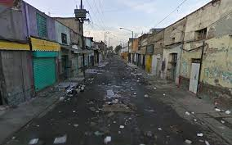
Status
-As lower status increases, price decreases
-$698/% of lower status

Slide 12
Unimportant Factors
Unimportant factors = Predictors had little effect on house price
-Zone, crime rate, non-retail business acres, nitrogen oxide concentration, age of the home, tax
-Black is engineered feature for which the

Slide 13
Conclusion
-Biggest 2 categories/ Things to Look for
-House size
-House location
-Accuracy of Data: Able to explain 57.5% of the variation

Slide 14
QUESTIONS?

Slide 15
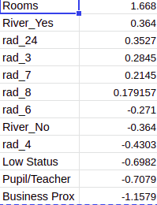
Technical Notes

Slide 16
The Model
Target_value = 3.754e+01 + -5.53e-02*w1 + 5.269e-02*w2 + -3.996e-03*w3 + -3.907e-02*w4 + 1.668e+00*w5 + -2.016e-02*w6 + -1.157e+00*w7 + -4.460e-03*w8 -7.079e-01*w9 + 1.004e-02*w10 + -6.98230657e-01*w11 + -3.6401e-01*w12 + 3.640e-01*13 + -1.798e-01w14 + -1.181e-01*w15 + 2.845e-01*w16 + -4.303e-01*w17 + -3.068e-02*w18 -2.719e-01w19 + 2.145e-01*w20 + 1.791e-01*w21 + 3.52777177e-01*w22

